Slide 1
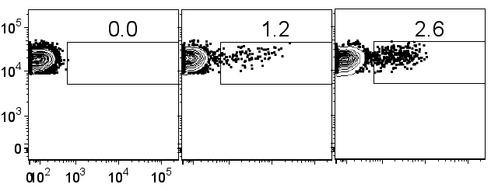
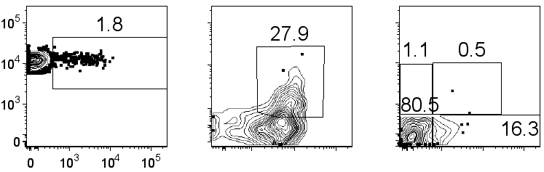
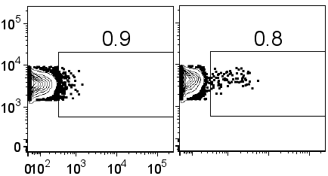
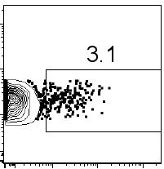
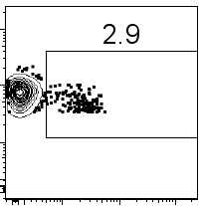
FIGURE 1
A
B6.IL21-VFP
B6
2 wk
4 wk
CD4
VFP
B
C
CD4
ICOS
PD1
VFP
CD44
CXCR5
D
B6.IFNγ-YFP
B6.IL10-GFP
B6.IL21-VFP
B6.FoxP3-GFP
CD4
Reporter
Notes:
LOOK AT HISTOGRAM OF VFP for spleen vs thymus **** = < 0.0001

Slide 2
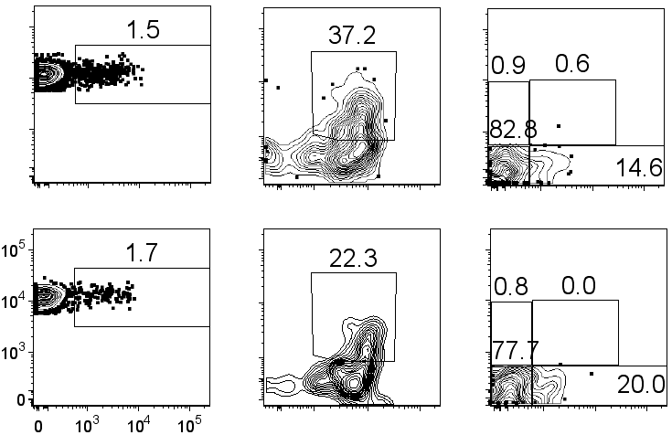
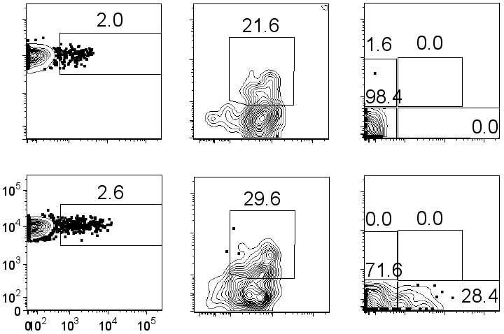
FIGURE 2
A
Ighm-/- IL21-VFP
B
Cxcr5-/- IL21-VFP
IL21-VFP
IL21-VFP
CD4
ICOS
PD1
CD4
ICOS
PD1
VFP
CD44
CXCR5
VFP
CD44
CXCR5
C
D
Notes:
Combine knockout and reporter data. Put reporter data first. Add FoxP3. Look at FoxP3 in the thymus. Genes and cytokines that drive them.

Slide 3
FIGURE 3
A
B
Functional enrichment
KEGG: Ribosome GO BP: Cellular macromolecule metabolic process
KEGG: Cytokine-cytokine receptor interaction GO BP: Lymphocyte and leukocyte activation Immune system process, Cellular metabolic process Regulation of inflammatory response Defense response Death
KEGG: T cell receptor signaling pathway GO BP: Adhesion Lymphocyte and lymphocyte activation Developmental process Positive regulation of cellular process T cell activation T cell proliferation
C
N2
N1
8 day N CD4T
8 day TH1 R2
8 day TH1 R1
ACT1
ACT2
8 day TFH2
8 day TFH1
8 day GCTFH2
8 day GCTFH1
IL21-ACT1
IL21-ACT2
Il21
Gpm6b
Tox2
Maf
N (149)
Sostdc1
Ifng
Nkg7
Tbx21
Tcf7
Bcl6
ACT (165)
ACT IL21 vs N
Prdm1
Il6ra
Il21r
IL21-ACT2
IL21-ACT1
3 day TFH2
3 day TFH1
3 day TH1 R2
3 day TH1 R1
ACT1
ACT2
N2
N1
Foxp1
Lef1
Foxo1
ACT IL21
ACT
N
Il2ra
Foxp3
ACT IL21 (158)
-1 0 1
ACT vs N
D
E
100
80
60
40
20
0
100
80
60
40
20
0
% of total TPM
% of total TPM
Bcl6
E2f2
Id3
Fosb
Tox
Tox2
Egr2
Maf
Nfatc1
Pou2af1
Tcf1
Lef1
Prdm1
Foxp1
Foxo1
Il21
Tnfsf8
Tgfb3
Angptl2
Il6ra
Il6st
Il21r
Cxcr5
Mki67
Cdc25b
Ccdc12
Ccdc28b
Tbc1d4
Myo1g
Ifng
Tbx21
Id2
Gzmb
Il12rb2
Nkg7
Sostdc1
Btla
Cd200
Slamf6
Gpm6b
Cd4
Cd28
Lag3
Il4
Gata3
Asb2
Klrg1
Serpina3g
Ccl5
Foxp3
Il2ra
Il12rb
Tnfrsf18
Tx Factors
Cytokines/
Receptors
Markers
Coreceptor
Cell Cycling
TH₁
TH₂
NKT
T_{REG}
Notes:
Figure 3. Functional enrichment in panel b: KEGG terms with p-values less than 0.01. nkg7 correct legend

Slide 4
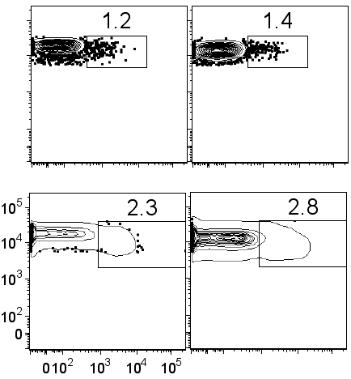
FIGURE 4
Trav10
Trav10d
Trav11
Trav11d
Trav12−2
Trav12−3
Trav12d−3
Trav12n−3
Trav13−1
Trav13−4−dv7
Trav14−1
Trav14−2
Trav14−3
Trav14d−1
Trav14d−2
Trav14d−3−dv8
Trav14n−1
Trav14n−2
Trav14n−3
Trav16
Trav16n
Trav17
Trav3−3
Trav4−2
Trav4−4−dv10
Trav5−4
Trav6−5
Trav6−6
Trav6−7−dv9
Trav7−2
Trav7−3
Trav7−4
Trav7−6
Trav7d−3
Trav7d−4
Trav7d−5
Trav8−1
Trav8−2
Trav9−1
Trav9−2
Trav9−4
Trav9d−1
Trbv12−2
Trbv13−2
Trbv13−3
Trbv15
Trbv16
Trbv19
Trbv2
Trbv20
Trbv29
Trbv3
Trbv31
Trbv4
Trbv5
A
N
-0.004
TPM
ACT
0.866
ACT
0.076
ACT IL21
B
TCRα -/- OT2
IL21-VFP
IL21-VFP
VFP
CD4
ICOS
Notes:
Fig 4 repertoire

Slide 5
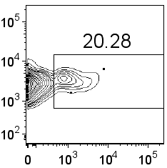
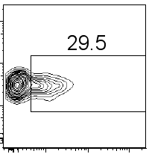
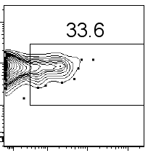
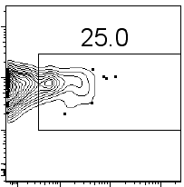
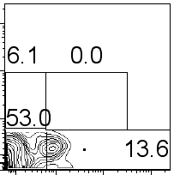
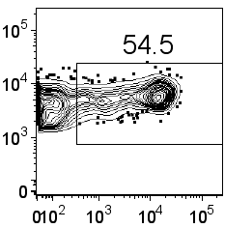
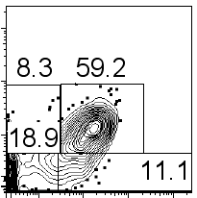
FIGURE 5
A
2 wks
4 wks
6 wks
CD4
VFP
B
C
D
Unimmunized
Immunized
PD1
CD4
VFP
CXCR5
Notes:
Figure 5. Adoptive transfer

Slide 6
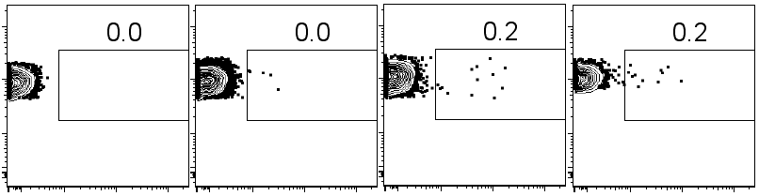
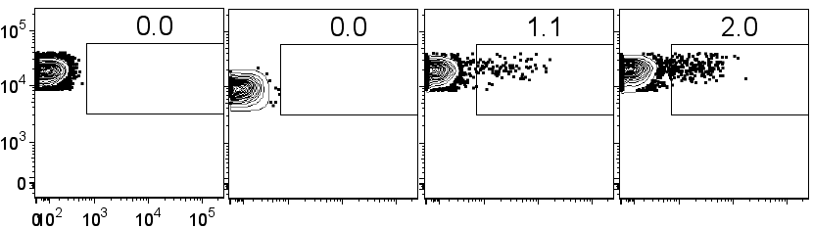
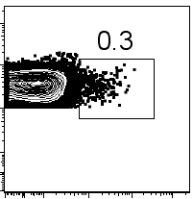
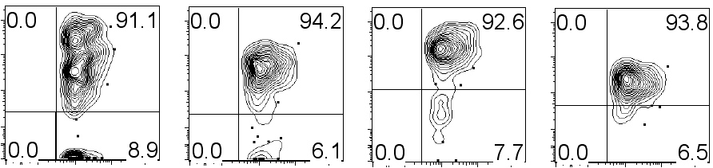
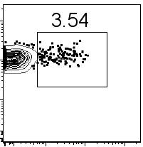
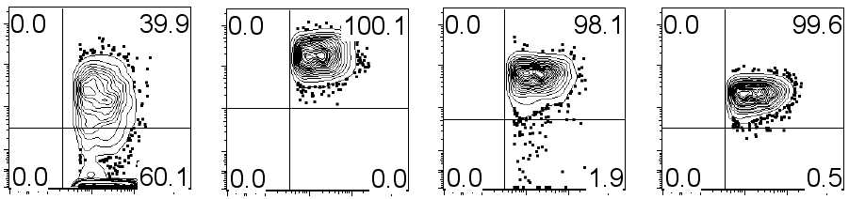
FIGURE 6
A
B6.IL21-VFP
B
C
B6
2 day
2 wk
4 wk
Thymus
B6
2 day
Spleen
CD4
VFP
D
ICOS
CD44
CD5
CD3e
Thymus
Spleen
CD4
ICOS
CD44
CD5
CD3e
VFP
VFP
E
F
Notes:
Figure 6. Thymus Histogram graph? Look at the activation profile of spleen and thymus and compare. Lymph node spleen and blood. No thymus. CFSE labeled. Thymic vs non thymic cells. Present transfer data that is pertinent to the thymus argument

Slide 7
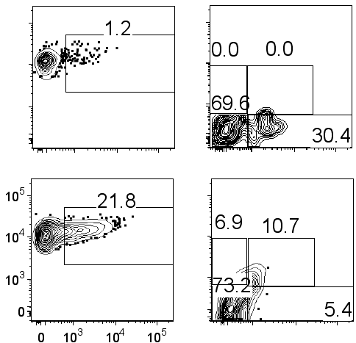
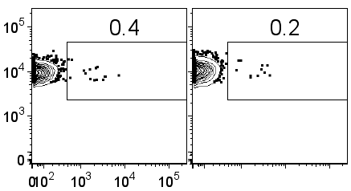
FIGURE 7
A
B
C
D
IL21 VFP
FoxP3-/- VFP
CD4
PD1
VFP
CXCR5
E
FoxP3-/-
IL21-VFP
IL21-VFP
CD4
VFP
Notes:
Figure 7.

